Slide 1
Toronto Crimes
TEAM-
Lavanya Mamillapalli QW21097
Bhaavani Madabathula
LeelaManikanta Cheekatla JX33255

Slide 2
Our motivation towards this project is, we want
to analyze on Toronto crimes to know the exact
number of crimes and types of crimes occurred in
Toronto during the period of 2014-2017.
Project Motivation
Here we can know the number of crimes occurred in a day or in a month or in a year, so that this is helpful to reduce the crime-rate in Toronto.
While doing this project there is a drastic change in growth of crimes in between the years 2014 and 2017, And most of the crimes are Assaults.

Slide 3
DATA DESCRIPTION
`OBJECTID`: an identifier for each record in the dataset
`EVENT_UNIQUE_ID`: a unique identifier for each crime event
`REPORT_DATE`: the date on which the crime was reported
`OCC_DATE`: the date on which the crime occurred
`REPORT_YEAR`: the year in which the crime was reported
`REPORT_MONTH`: the month in which the crime was reported
`REPORT_DAY`: the day of the month on which the crime was reported
`REPORT_DOY`: the day of the year on which the crime was reported
`REPORT_DOW`: the day of the week on which the crime was reported
`REPORT_HOUR`: the hour of the day at which the crime was reported
`OCC_YEAR`: the year in which the crime occurred
`OCC_MONTH`: the month in which the crime occurred
`OCC_DAY`: the day of the month on which the crime occurred
`OCC_DOY`: the day of the year on which the crime occurred
`OCC_DOW`: the day of the week on which the crime occurred
`OCC_HOUR`: the hour of the day at which the crime occurred

Slide 4
`DIVISION`: the police division responsible for the reported crime
LOCATION_TYPE`: the type of location where the crime occurred​
- `PREMISES_TYPE`: the type of premises where the crime occurred​
- `UCR_CODE`: the Uniform Crime Reporting (UCR) code for the reported crime​
- `UCR_EXT`: the UCR code extension for the reported crime​
- `OFFENCE`: the type of offence committed​
- `MCI_CATEGORY`: the Major Crime Indicator (MCI) category for the reported crime​
- `HOOD_158`: the name of the neighbourhood (158 subdivisions) where the crime occurred​
- `NEIGHBOURHOOD_158`: the neighbourhood (158 subdivisions) where the crime occurred​
- `HOOD_140`: the name of the neighbourhood (140 subdivisions) where the crime occurred​
- `NEIGHBOURHOOD_140`: the neighbourhood (140 subdivisions) where the crime occurred​
LONG_WGS84: the longitude of the location where the crime occurred (in the WGS84 coordinate system)
LAT_WGS84: the latitude of the location where the crime occurred (in the WGS84 coordinate system)

Slide 5
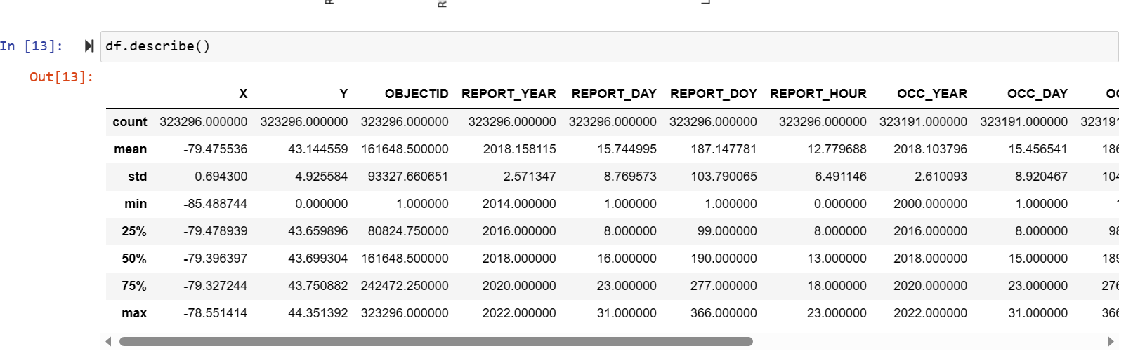
Descriptive statistics of a Dataframe

Slide 6

Exploratory Data Analysis(EDA)

Slide 7
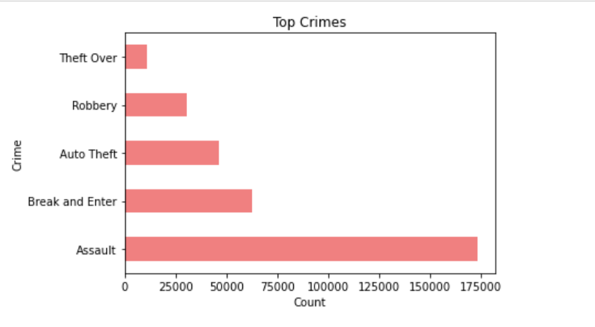
This is the visualization for top crimes in TORONTo.
If we observe here the highest crime occurred in TORONTo is “ASSAULT”.
TOP CRIMES

Slide 8
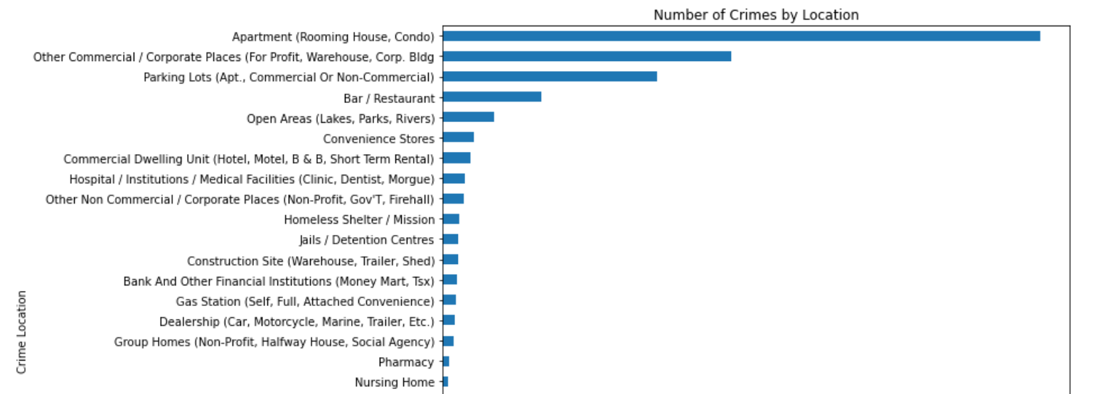
Crimes By Location
Here in this visualization, we can observe the crimes occurred by location and the large number of crimes occurred in Apartments and some commercial places.
And the least number of crimes occurred in Pharmacy and Nursing homes.

Slide 9
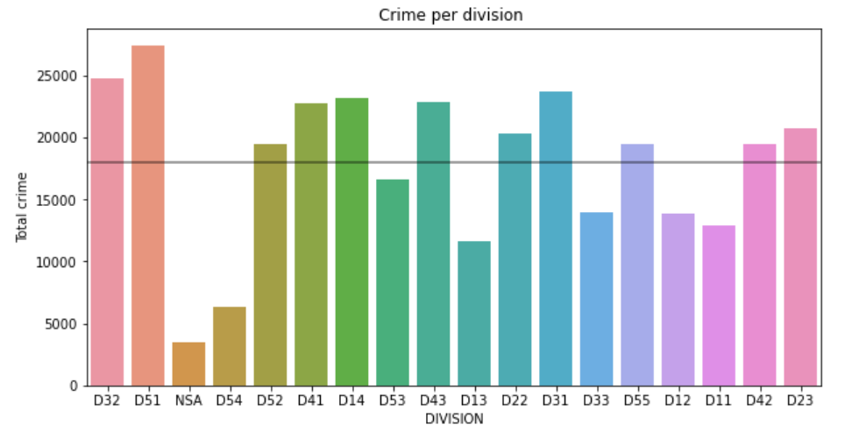
Crimes per division
Here the visualization shows crimes per division. Most of the crimes happened in the “D51”​ division.​
And the least crimes occurred in "NSA" division.​

Slide 10
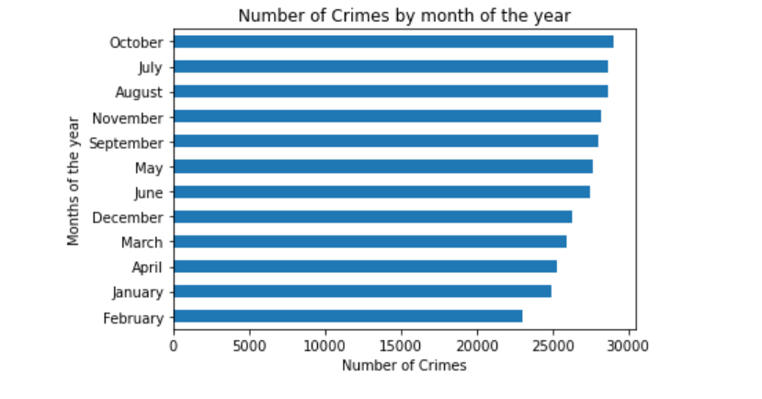
Number of Crimes by month of the year

Slide 11
MODEL:
Logistic Regression Classifier:​
Logistic Regression is the most basic model that usually
works on any data frame and the scores given by the logistic
regression are accurate depending upon my data set.​

Slide 12
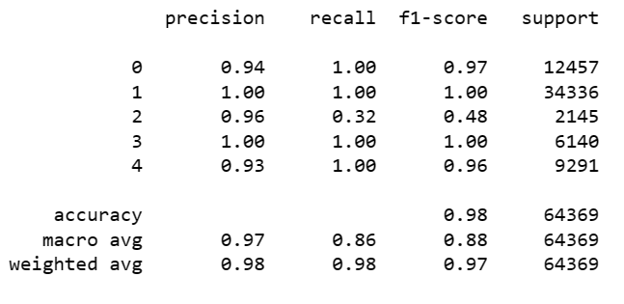
MODEL RESULTS
Logistic Regression score: 97.66 %​
Accuracy Score: 98%​

Slide 13



A typical approach is, to improve a model to use more data. In this case, I have only taken the useful data but including whole can improve the overall score.
We could try various techniques, such as a Random forest Classifer, Gradient boosting, but this could lead to additional problems and is overkill.
For more exploration we can use ensemble models, by using this the scores may get imporved.

Slide 14


THANK YOU

